Slide 1



CONTENTS
KUPPAM ENGINEERING COLLEGE
(Recognition by AICTE,New Delhi, Affiliated to JNTU-Ananthapuram) KES NAGAR ,KUPPAM - 517425,CHITTOOR DISTRICT,A.P.
ABSTRACT
INTRODUCTION
LITERATURE SURVEY
EXISTING SYSTEM
PROPOSED SYSTEM
SYSTEM DESIGN
MODULES
METHODOLOGY
CONCLUSION
REFERNCES
ELECTION RESULT PREDICTION USING TWITTER SENTIMENTAL ANALYSIS
DEPARTMENT OF COMPUTER SCIENCE AND ENGINEERING
PRESENTED BY
UNDER THE GUIDANCE OF
M. Nithish Kumar (20F41A0564)
S. Dilliraj (20F41A0591)
P.R. Sai Nagendra (20F41A0581)
S. Sumathi (20F41A0594)
Ms. LYDIA MTech.,
Assistant Professor
Department of Computer Science and Engineering
KUPPAM ENGINEERING COLLEGE

Slide 2
CONTENTS
ABSTRACT
INTRODUCTION
LITERATURE SURVEY
EXISTING SYSTEM
PROPOSED SYSTEM
SYSTEM REQUIREMENTS
SYSTEM DESIGN
WORKFLOW DIAGRAM
MODULES
METHODOLOGY
RESULT
CONCLUSION
REFERNCES

Slide 3
1. ABSTRACT
Predict election outcomes via sentiment analysis of election-related tweets.
Collect diverse tweet data, including hashtags and candidate mentions.
Utilize Natural Language Processing to analyze sentiment towards candidates and overall election sentiment.
Visualize sentiment analysis results using various libraries such as TextBlob, matplotlib, seaborn, plotly, and pandas.
Train machine learning models like random forests on the extracted features.
Evaluate model performance using metrics like accuracy, precision, and recall, then deploy the model to provide real-time election sentiment insights.

Slide 4
2. INTRODUCTION
In the era of modern politics, precise prediction of election outcomes is vital for informed decision-making.
Traditional methods such as polling and historical data analysis, while reliable, often lack real-time insights.
Our system integrates real-time social media sentiment analysis for a paradigm shift.
Platforms like Twitter, Facebook, and Instagram offer powerful channels for opinion sharing
Advanced machine learning and sentiment analysis tools analyze public sentiment in real-time.
This approach enhances precision, providing timely insights into voter sentiments and trends for informed decision-making.

Slide 5
3. LITERATURE SURVEY
Author Name and Year Of Publishing | Title | Outcomes | Disadvantages
[1]DiGrazia et al. [2013] | "Predicting Elections with Twitter: What 140 Characters Reveal about Political Sentiment" | Achieved high prediction accuracy for U.S. House and Senate elections. | potentially lacking generalizability to other countries Limited to 140-character constraint
[2]Jungherr et al. [2016] | "Predicting US Primary Elections with Twitter: A Political Spectrum Perspective" | Predicting primary election outcomes using Twitter data and supervised learning. | limiting applicability to other types of elections

Slide 6
[3]Kouloumpis et al. [2018] | "Using Twitter Data for Predicting Election Results: A Comprehensive Review" | Emphasis on the importance of feature selection, sentiment analysis, and machine learning algorithms. | Lack of original empirical research Limited to reviewing methodologies
[4]Gayo-Avello [2012] | "Predicting Elections from Social Media: A Review" | Examination of various techniques for predicting elections from Twitter. | Published prior to the widespread use of machine learning in social media analysis

Slide 7
4. EXISTING SYSTEM
Existing systems for predicting election results rely on traditional methods like polling, historical data analysis, media analysis, and exit polls.
These methods entail conducting surveys, analyzing past election data and trends, monitoring news coverage, and public discourse.
Exit polls provide immediate feedback on voting behavior.
Limitations:
Costly and Time-consuming
Limited Sample Size
Bias and Subjectivity
Static Analysis

Slide 8
5. PROPOSED SYSTEMS
Real-Time Sentiment Analysis: Analyze social media data from platforms like Twitter, Facebook, and Instagram for instant feedback on voter sentiment.
Machine Learning Models: Develop advanced models like Random Forest trained on social media sentiment to predict election outcomes.
Natural Language Processing (NLP): Preprocess text data for sentiment analysis.
Data Visualization: Real-time sentiment and predictions interactively.
Advantages :
Timeliness
Big Data Utilization
Cost-Effectiveness
Reduced Bias & Enhanced Accuracy

Slide 9
6. SYSTEM REQUIREMENTS
HARDWARE:
OS : Windows 10
RAM : 8GB
Processor : Intel i5 Core Processor
SOFTWARE:
Software : Python 3.6
IDE : VS Code
Libraries : Pandas, Numpy, Seaborn, Matplotlib, TextBlob, WordCloud, Plotly

Slide 10
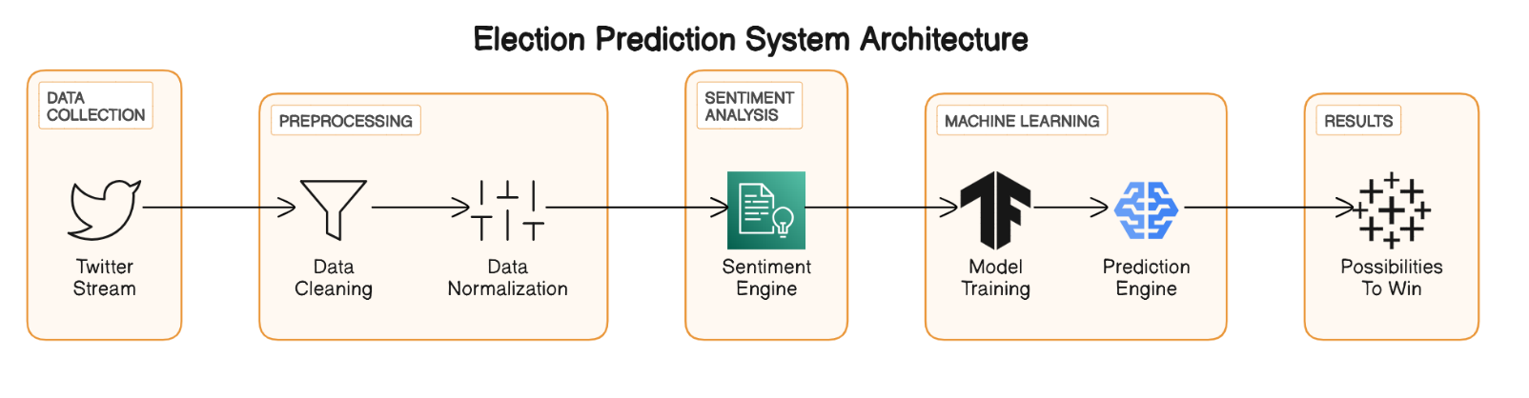
7. SYSTEM DESIGN
Architecture Diagram

Slide 11
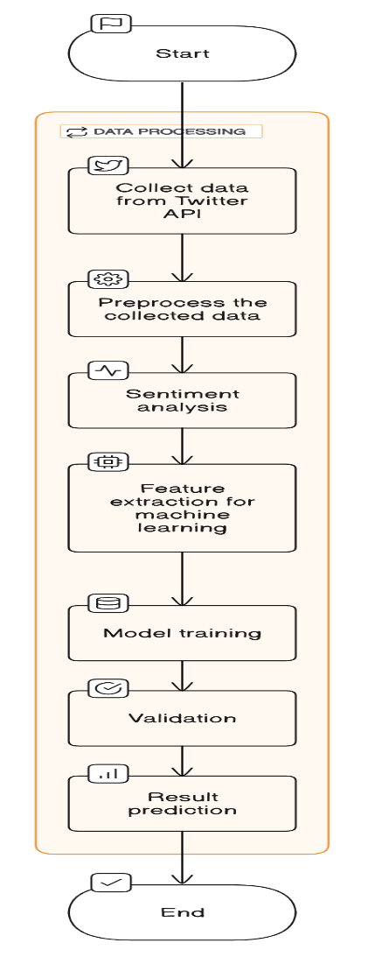
8. WORKFLOW DIAGRAM

Slide 12
9. MODULES
1. Upload the dataset
Here the user will load the dataset into the program.
2. Run the model
Here the user will run the model.
3. Predict the result
Here the model predict the result.
4. Visulize the result
After successfully predicting the result now user can see the result in
form of plots.

Slide 13
10. METHODOLOGY
Data Collection: Utilize Twitter API to collect election-related tweets. Filter based on keywords and hashtags.
Data Preprocessing: Cleanse data to remove noise and duplicates. Tokenize text and handle missing values.
Feature Extraction: Extract text features, user engagement metrics, and temporal patterns.
Sentiment Analysis: Classify sentiments using machine learning or lexicon-based approaches. Evaluate performance metrics.
Model Training: Train machine learning models on labeled data. Optimize hyperparameters.
Prediction and Interpretation: Deploy models to predict election outcomes. Interpret results visually.

Slide 14
11. RESULT
Utilize Twitter API for data collection.
Cleanse and preprocess the collected data.
Extract relevant features from the preprocessed data.
Perform sentiment analysis using machine learning or lexicon-based approaches.
Train machine learning models on labeled data.
Deploy trained models to predict election outcomes and interpret the results.

Slide 15
12. CONCLUSION
The project has successfully developed a methodology for predicting election outcomes using Twitter sentiment analysis.
By leveraging Twitter data and advanced machine learning techniques, the project has demonstrated the potential for real-time monitoring and prediction of public sentiment.
The methodology provides valuable insights into voter sentiment and electoral dynamics, contributing to a deeper understanding of political processes.
Future research could focus on refining the methodology, incorporating additional data sources, and exploring novel techniques for improving prediction accuracy.
Overall, the project highlights the transformative potential of social media data analysis in informing decision-making processes and shaping our understanding of societal dynamics.

Slide 16
13. REFERENCES
[1] A. Sarlan, C. Nadam, and S. Basri, “Twitter sentiment analysis,” in Pro- ceedings of the 6th International conference on Information Technology and Multimedia, pp. 212–216, IEEE, 2014.
[2] P. Lai, “Extracting strong sentiment trends from twitter,” 2010.
[3] A. Tumasjan, T. O. Sprenger, P. G. Sandner, and I. M. Welpe, “Predict- ing elections with twitter: What 140 characters reveal about political sentiment,” in Fourth international AAAI conference on weblogs and social media, Citeseer, 2010.
[4] P. Salunkhe and S. Deshmukh, “Twitter based election prediction and analysis,” International Research Journal of Engineering and Technol- ogy (IRJET), vol. 4, p. 10, 2017.
[5] F. Nausheen and S. H. Begum, “Sentiment analysis to predict election results using python,” in 2018 2nd international conference on inventive systems and control (ICISC), pp. 1259–1262, IEEE, 2018.
[6] F. J. J. Joseph, “Twitter based outcome predictions of 2019 indian gen- eral elections using decision tree,” in 2019 4th International Conference on Information Technology (InCIT), pp. 50–53, IEEE, 2019.
[7] L. Wang and J. Q. Gan, “Prediction of the 2017 french election based on twitter data analysis,” in 2017 9th Computer Science and Electronic Engineering (CEEC), pp. 89–93, IEEE, 2017.

Slide 17
THANK YOU

